Slide 3
Understanding Technological Device Addiction in America
Dr. Justin Nelson
Sociology
Wiggins Memorial Library
Lightning Talks
Fall 2022

Slide 4
What Do I Study?
How prevalent is technological device addiction in the broader adult population in the U.S.?
What social and demographic variables are related to technological device addiction?
What is the relationship between meaning-seeking and technological device addiction?
What is the relationship between technological device addiction and social integration? How do the tech-addicted feel about their social relationships?

Slide 5
How Do I Study It?
Secondary Data Analysis / Survey Research
Baylor Religion Survey
Key Questions / Variables:
Tech Addiction
I feel addicted to the technological devices I have.
I would panic if my phone suddenly stopped working.
Social and Demographic Variables
Education, Work Status, Gender, Social Media Use, etc.
Meaning in Life Questions (Steger, 2006)
I am seeking something meaningful in my life.
I have found a satisfying life purpose.
Social and Felt Integration
Family Closeness
Friends Closeness
People Dislike Me
Missed Out on Fun
Feel Important to Others
Feel Helpless

Slide 6
What Have I found?
“Who’s an iAddict?: A Sociodemographic Exploration of Device Addiction Among American Adults.” Social Science Quarterly.
Roughly one-fourth of American adults self-report tech addiction, which is correlated with increased education, employment, and social media use (Nelson and Pieper, 2020).
“‘Maladies of Infinite Aspiration’: Smartphones, Meaning-Seeking, and Anomigenesis.” Sociological Perspectives.
Seeking meaning in one’s life is positively correlated with reports of smartphone attachment (Nelson and Pieper, 2022).
“Integration or ‘Instagration’: A Closer Look at Connection in the Digital Age.” In progress.
Tech-addicted people feel less close to their friends and are more likely to report fear of missing out and feeling like people dislike them (Nelson and Pieper, in progress).

Slide 7
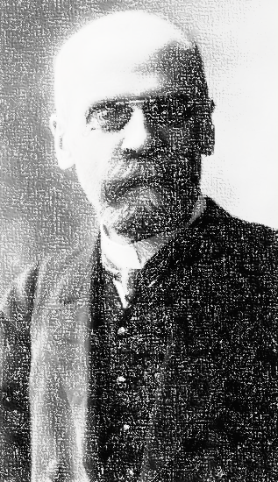
Digital Durkheim
New media
Old problems

Slide 8
Digital Durkheim
Tech addiction as a “malady of infinite aspiration” (Durkheim, 1925)
Moderns are “powerless to fulfill themselves because they have been emancipated from all limitations” (Durkheim, 1925)
With no boundaries to guide online behavior, seeking may lead to addiction precisely because smartphones provide everything.

Slide 9
“Instagration” & Anomie

Slide 10
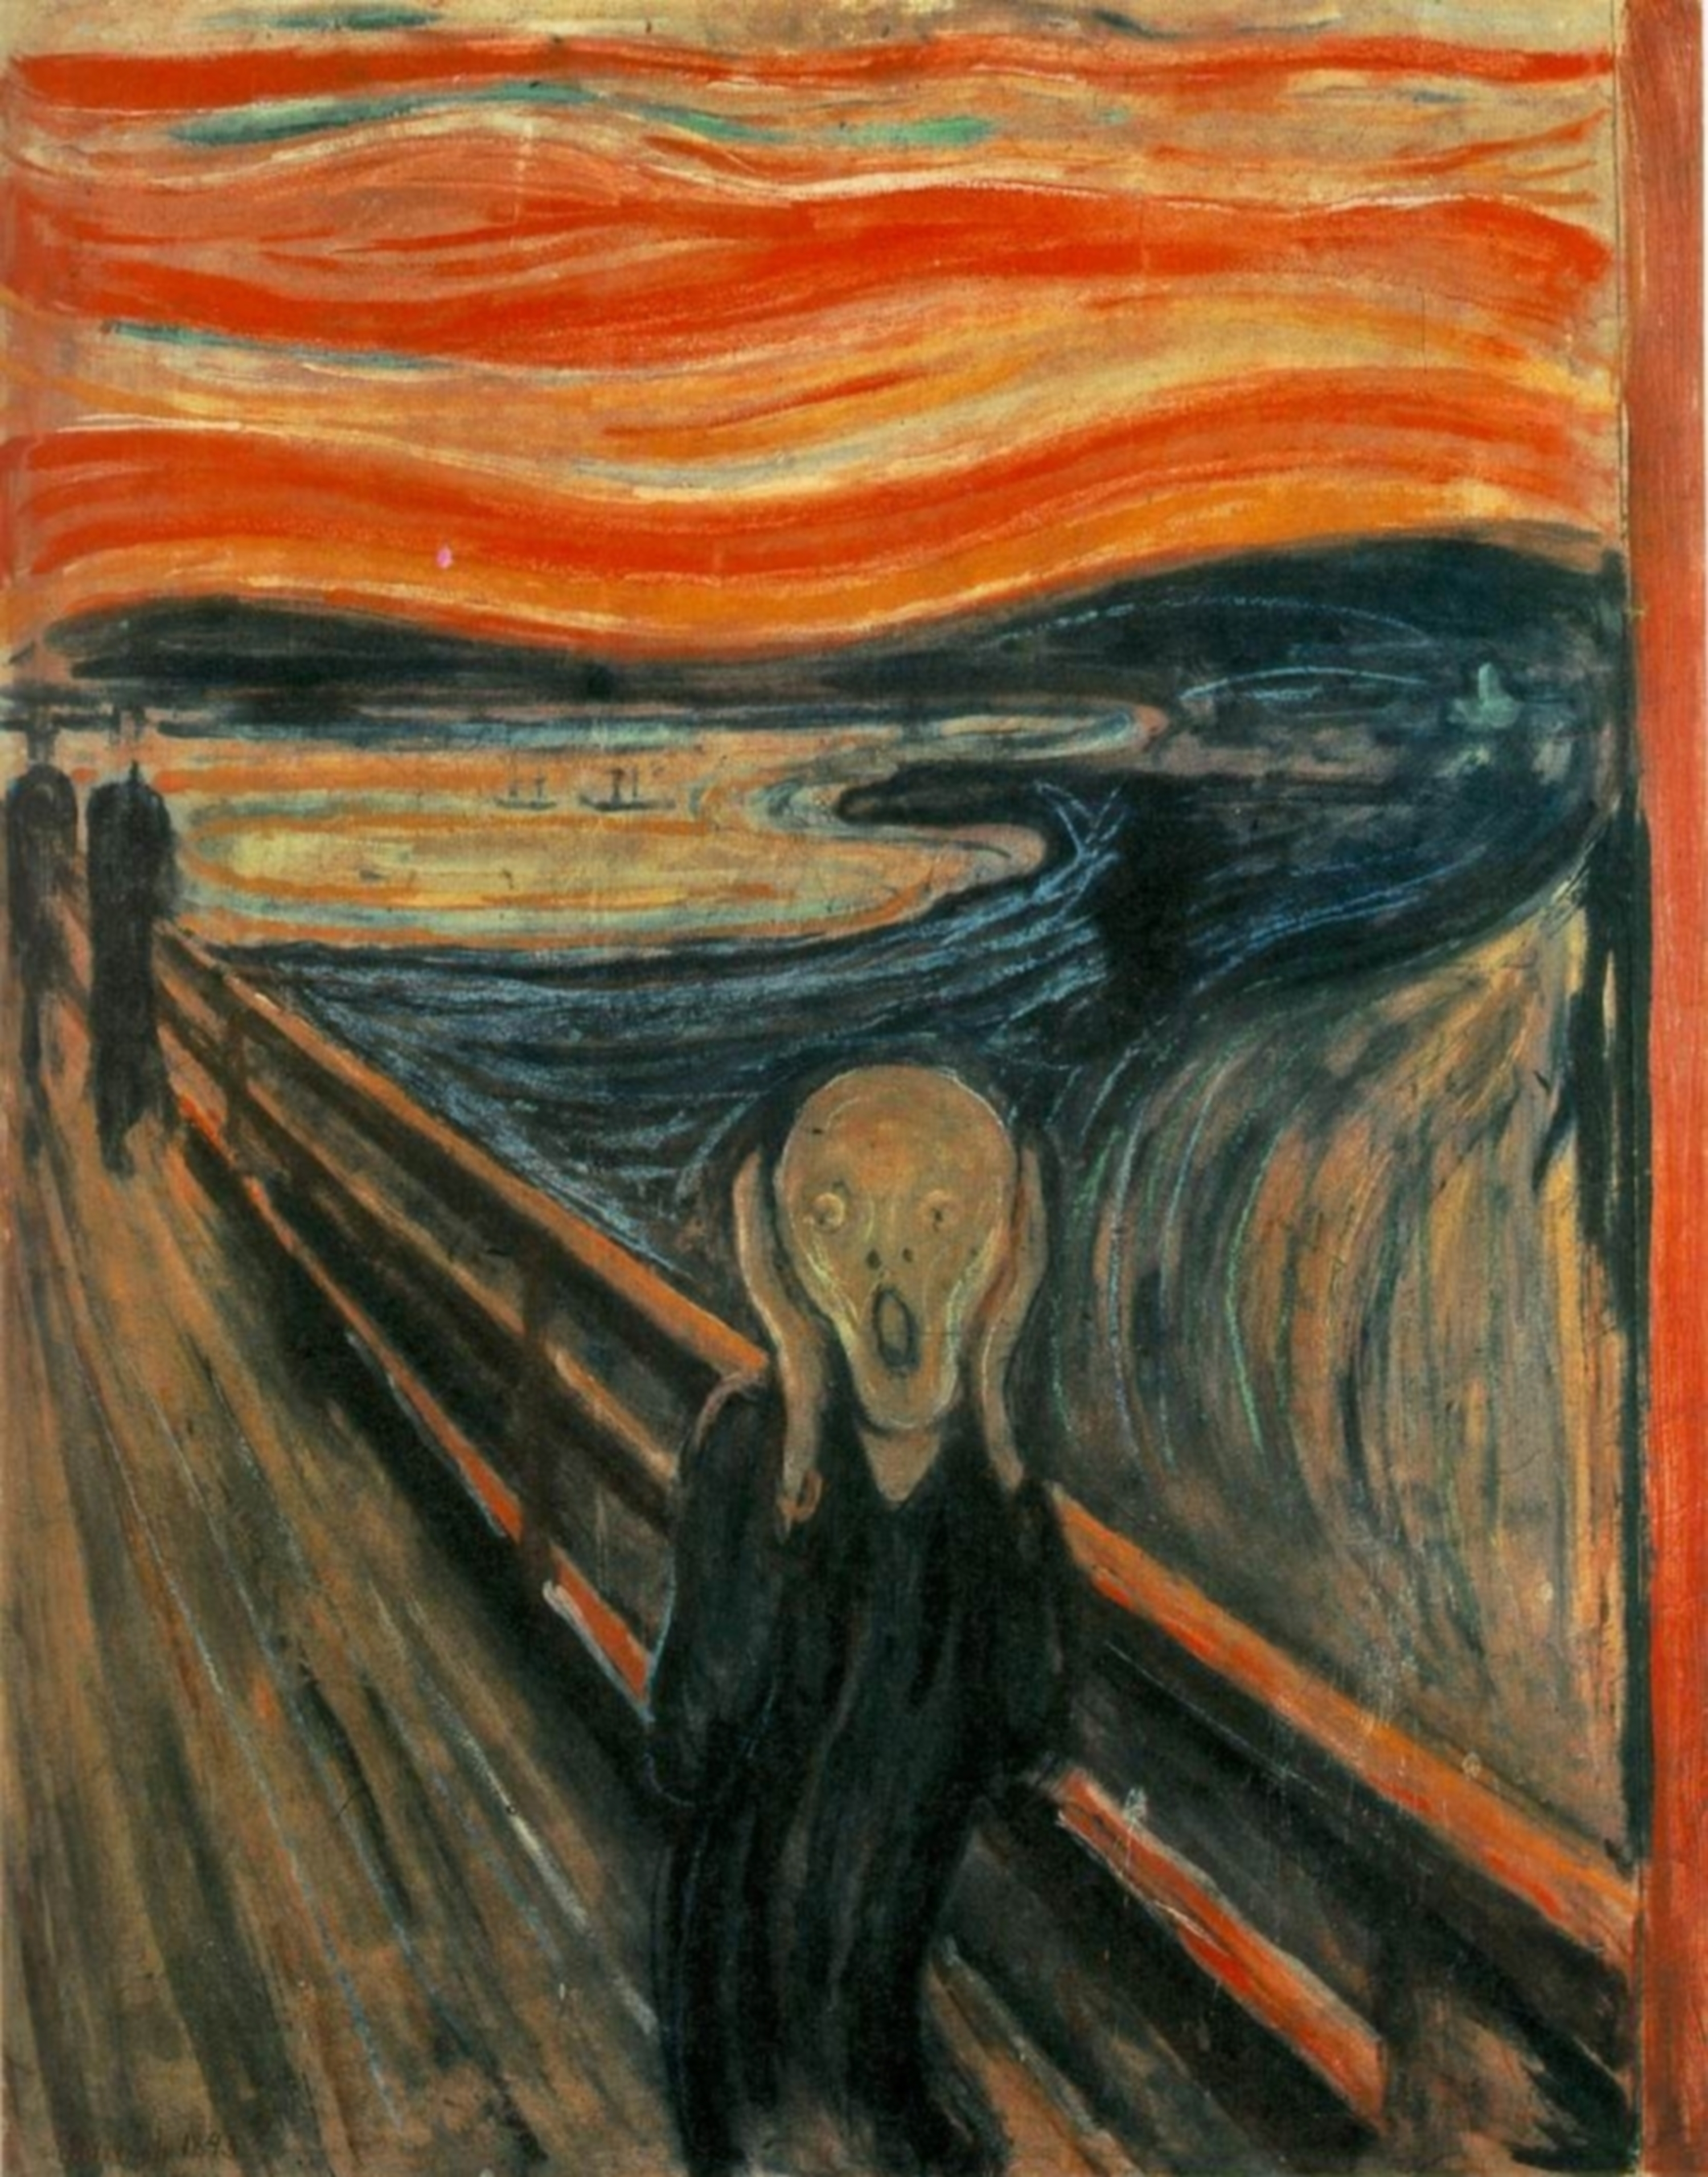
“Instagration” & Anomie
Tech as telos
Postman (1995) on “god of technology”
For some users, tech promises to relieve anomie, but actually ends up worsening it
Tech offers feeling of connection, but produces greater feelings of isolation
“Instagration” is not social integration!

Slide 11
THANK YOU
Dr. Justin Nelson, Sociology
nelsonj@campbell.edu

